Slide 1


Linux
Interacting With Linux

Slide 2
Kernel and Shells
The core or key components of the operating system consists of many kernel subsystems such as:
Process management
Scheduling
File management
Device management
Network management
Memory management

Slide 3
Kernel and Shells
Since users cannot command the kernel directly, Unix has a command language known as the shell.
Shells are command line interpreters that are capable of executing commands read from input or a from a file.
The word shell implies a layer around the kernel.
A shell is a user interface, or command interpreter.
hardware
kernel
shell

Slide 4
Kernel and Shells
Shells provide the end user with an interface to the system by using built-in commands and enabling external programs to be run.
Traditionally a command line is provided for this purpose, hence the alternative name for a shell – command line interface (CLI).
A shell requires no special privileges to do its job, and anyone can write their own shell
On Linux the shells are highly developed, and usually extensions of the old UNIX shells.

Slide 5
Kernel and Shells
The Bourne-Again Shell (bash) merges the features of the three standard UNIX shells, and adds some of its own. It is the default shell on Linux.
The Turbo C-shell takes the standard UNIX C-shell and adds extensions.
The Z-shell takes the basic Korn shell and provides an enormous number of extensions – the program itself is twice as large as a basic Korn shell.
All these shells are usually referred to by their program names, Bourn-Again Shell is bash, Turbo C-shell is tcsh, and Z-shell is zsh. However, they can all emulate the behaviour of the old UNIX shells

Slide 6
Anatomy of a Command
Below is an example of a command entered in to the shell
Single character, or short options are most common
Can combine many options with a single hyphen ‘-’
Multi character, or long options are common with GNU utilities
Proceeded with 2 hyphens ‘--’
Option in full word
Options are not ordered, but can require arguments of their own.
$ ls -l --color -- /home/bobby <CR>
command
‘short’ options
‘long’ options
end of options marker
end of command
object(s)
shell prompt

Slide 7
Entering a Command
The shell will prompt when it is ready to receive a command. The default prompt characters are:
$ for the Bourne and Korn shells
% for the C shell
# for any shell run by the super user
The shell reads all the characters typed until the Return/Enter (<CR>), key is pressed. When <CR> is pressed, the shell divides the line into a number of words, separated by white space characters (space and/or tab).
The first word is interpreted as the command and subsequent words are interpreted as arguments to the command.
As the shell recognises upper-case and lower-case characters, it is possible to have two commands or filenames whose names differ only in the use of case; for example, cal and Cal would be different commands.

Slide 8
Command Arguments
In many cases, a command will have arguments. These could be objects, such as files, on which the command is to work, and/or options to control the way the command behaves.
The example shows a number of arguments applied to the command 'ls', which is used to list details about files. Without any arguments, ‘ls’ simply lists the names of all the files in the current directory.
The example shows the use of the l and the a options to ls.
The l option signifies that the output from the command is to be in “long” format, showing more details about each file than just its name.
The a option asks ls to show so called 'hidden' files.
$ ls -la

Slide 9
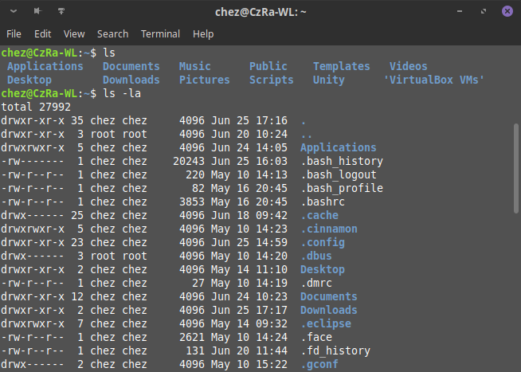
Command Arguments
Options can be combined, and in any order:
ls –la
ls –al
ls –l –a
ls –a –l
all do the same thing.
Each command has its own list of recognised
options and arguments. You should check the
reference manual for any details on this.

Slide 10
Command Line Scan
When we type a command at the shell prompt, we can continue the line for as long as we want, until we type the carriage-return character (<CR>). This character is one of the shell's special characters, and the shell understands it as the end-of-line marker.
Once the shell receives the <CR>, it will parse the entire line. This involves scanning the line from left to right, one character at a time. Every character the shell reads is interpreted and the line is recreated accordingly.
If a character is "normal”, it will be put straight back onto the line. Any special character (special shell characters are often referred to as meta-characters) will be actioned and the result of that action will be substituted back on the line.

Slide 11
Command Line Scan
If we type the following command, the shell will read each character on that line looking for special characters needing action. It will come across the dollar sign, $, and the asterisk, *.
$ ls -l $HOME /tmp/* <CR>
Both of these characters are special and need to be evaluated. The result of this evaluation will be put back on the line. After this, the recreated line may look like this:
$ ls -l /home/laura /tmp/ins.log /tmp/logfile.txt
Now, and only now, after the scan, will the shell try to locate the command

Slide 12
Shell Meta-Characters
The shell interprets certain characters in different ways:
Several other characters are also recognised by shells
For example ; (semicolon) allows to separate commands
Use ‘man bash’ for a full list and description
whitespaces space and tab for horizontal spacing and newline for vertical spacing
wildcards to generate filenames (aka globbing)
quotations to protect other special characters from the shell scan
expansions to provide variable and command substitution
redirection to manipulate data streams used (and generated) by commands

Slide 13
Expanding wildcard characters (globbing)
All UNIX shells expand wildcards before invoking the specified command
Expansion of wildcards means generating filenames
The command is given a list of matched filenames
Wildcards are expanded at all points on the command line
The shell has no knowledge of the underlying command
Filenames are matched in the given directory
What the user typed:
What is passed to the command:
THE SHELL
SCAN
my*
my myfile1 myfile2 myprog
/tmp/my*
/tmp/myriad /tmp/mystic /tmp/myrtle /tmp/myth

Slide 14
File name shorthand
The shell carries out globbing (wildcard expansion)
Does not include filenames starting with a dot .
Example:
* zero or more characters
? exactly one character
[abc] one character, either a or b or c
[A-Z] one character, in the range A-Z
[!abc] one character, neither a nor b nor c
~ the user's home directory
list files within our home that start with q and end with a digit
$ ls ~/q*[0-9]

Slide 15
Shell character classes
Available in ksh and bash
Help in avoiding ‘locale’ problems with character matching
Common character classes:
alnum, alpha, digit, lower, upper, punct
Examples: comparison of character set with character class notations
$ ls [A-Z]*
$ ls /etc/[!a-z]*
$ ls [a-z]*[0-9]
$ ls [[:upper:]]*
$ ls /etc/[![:lower:]]*
$ ls [[:lower]]*[[:digit:]]

Slide 16
Variable and command expansion
Assigning variable value
Reading variable value (variable expansion)
Command expansion:
$ Log_File=mylog1
no spaces around = sign
$ echo $Log_File
mylog1
$ echo ${Log_File}
mylog1
two syntax methods:
$var and ${var}
$ version=$(uname –r)
$ echo $version
2.6.18-92.el5
$ version=`uname –r`
$ echo $version
2.6.18-92.el5
`back-ticks` are difficult to read

Slide 17
Examples of command substitution
Create messages (possibly log entry)
Automate variable assignment
Command substitutions can be nested
$ tty
/dev/console
$ date +%D
03/25/98
$ echo "I am working on $(tty) screen"
I am working on /dev/tty1 screen
$ echo "Today’s date is: $(date +%D)"
Today’s date is: 03/25/98
$ Time_stamp="Backup started at $(date)"
$ echo $Time_stamp
Backup started at Wed Apr 7 21:43:38 BST 1999
$ echo $(basename $(tty))
console

Slide 18
Quoting
Prevent the shell from recognising special characters:
Quotes are also used to preserve spaces or tabs
' single quotes disable recognition of all special characters
" double quotes protect most special characters, with few exceptions (to allow variable and command substitution)‏
\ backstroke "escapes" special meaning of the next character
$ echo *.c
main.c temp.c fred.c
$ echo '*.c'
*.c
$ echo Fred Bloggs
Fred Bloggs
$ echo 'Fred Bloggs'
Fred Bloggs

